Slide 1
CMPBIO210, IB201, IB120
Introduction to Quantitative Methods In Biology
Denis Titov –Lecture 8
Cell Signaling and Cell Cycle model

Slide 2
Overview of Part I of the course Differential equations
What biological processes can differential equations describe?
How to convert an idea/model/mechanism into differential equations?
How to use a computer to easily solve differential equations?
How to plot/analyze/interpret the solutions?
Most lectures will have a component of writing/discussing/reviewing python code, so you’ll learn some python/programming along the way

Slide 3
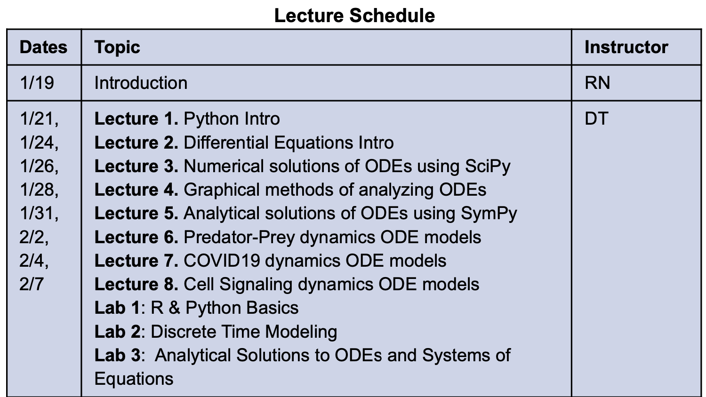
Overview of Part I of the course Differential equations

Slide 4
What should you learn from today’s lecture?
Brief overview of cell cycle regulation
How to make a model of cell cycle that cycles?
How to find and analyze the solution to this model?
Introduction to dynamic systems theory for analysis of dynamic properties of systems of ODEs

Slide 5
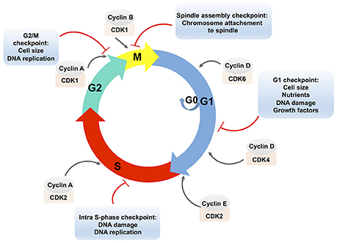
Eukaryotic cell cycle
Image credit: https://doi.org/10.3389/fcimb.2017.00208

Slide 6
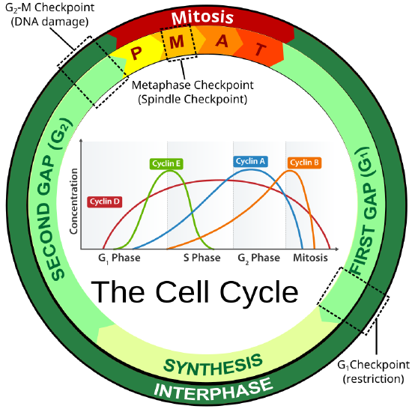
Cell cycle checkpoints and regulation
Image credit: https://bio.libretexts.org/Bookshelves/Human_Biology/Book%3A_Human_Biology_(Wakim_and_Grewal)/07%3A_Cell_Reproduction/7.2%3A_Cell_Cycle_and_Cell_Division

Slide 7
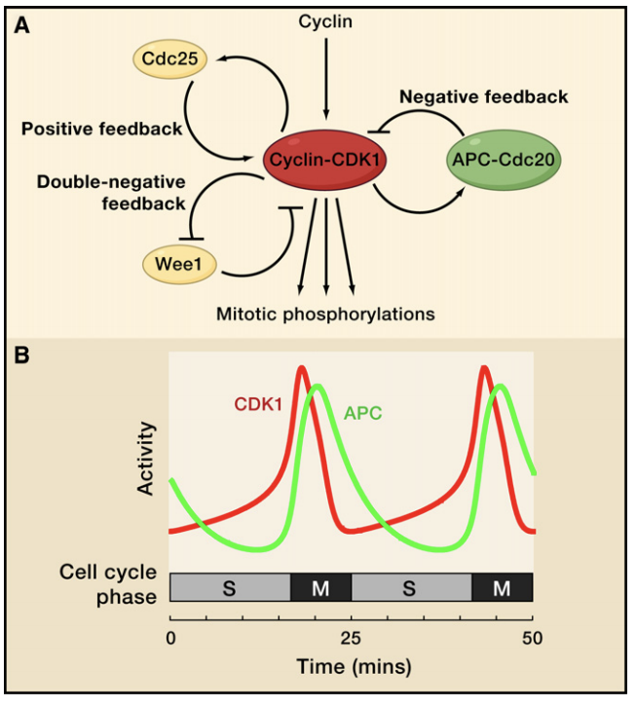
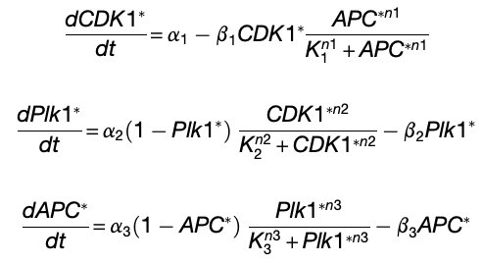
Mechanistic mathematical models
Figures from https://www.cell.com/action/showPdf?pii=S0092-8674%2811%2900243-1
Optional reading on the topic of value of mechanistic mathematical models in biology:
J. Gunawardena. Models in biology: ‘accurate descriptions of our pathetic thinking’
R. Phillips. Theory in Biology: Figure 1 or Figure 7?
J. Cohen. Mathematics Is Biology’s Next Microscope, Only Better; Biology Is Mathematics’ Next Physics, Only Better.

Slide 8

Let’s numerically solve some differential equations with python
You can open Jupyter Hub that we’ve setup for you at the following link with your CalNet ID:
https://biology.datahub.berkeley.edu/hub/user-redirect/git-pull?repo=https%3A%2F%2Fgithub.com%2FIB120-201-CCB210%2FSpring2022&urlpath=tree%2FSpring2022%2F&branch=master

Slide 9
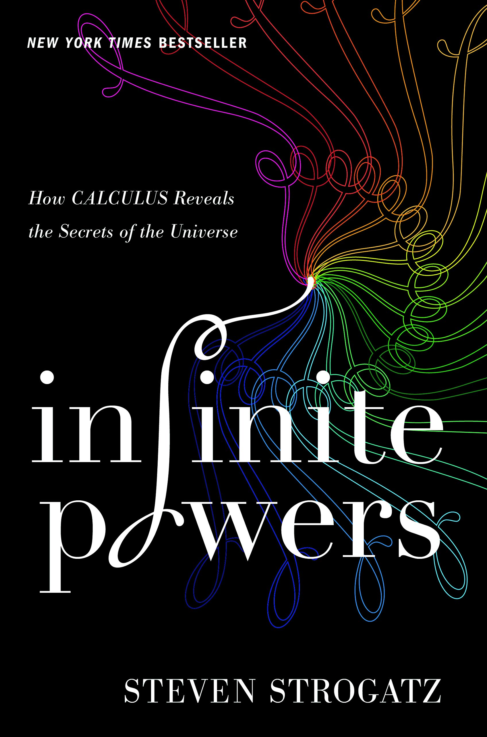
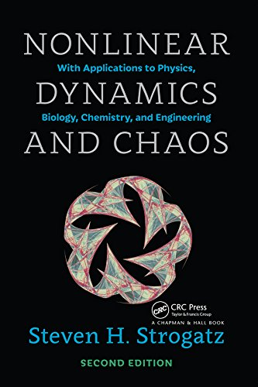
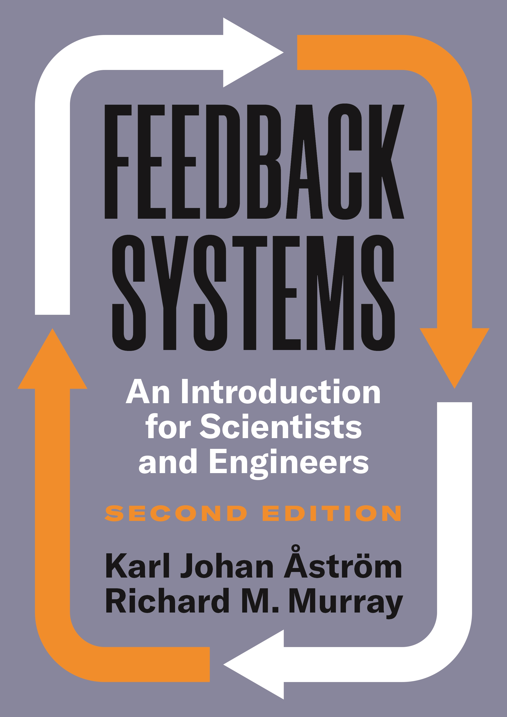
Additional optional reading if you want to learn more about differential equations and modeling
History and overview of calculus for non-scientists
Intro textbook for Nonlinear Dynamics and Chaos
Intro textbook for Dynamical Control

